Slide 1
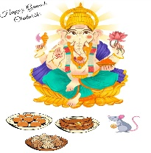

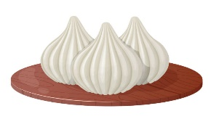
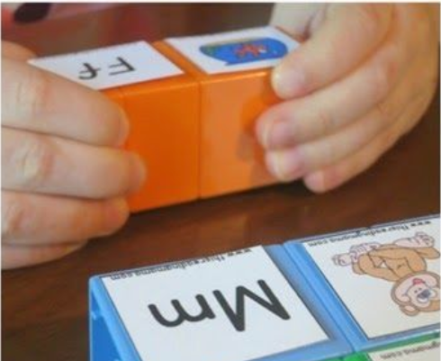
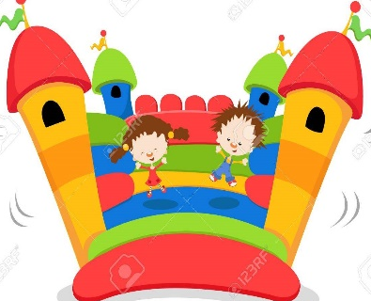
Level 1 Calendar
September 2024
Theme – My Farm and Pet Animal Friends
Monday 2nd | Tuesday 3rd | Wednesday 4th | Thursday 5th | Friday 6th
Prayer Rhymes Weather Golden Rules Circle Time- Introduction to the theme through Theme Board and Toy Animals Mindfulness- Walking Barefoot on the Grass Animated Video & Rhyme- Introduction to Five Senses Nutrition Week: Enactment of healthy & unhealthy food Bouncy Time | Prayer Rhymes Weather Golden Rules Circle Time- Fun Facts About Farm and Pet Animals Through an Animated Video (Pig, Cow, Dog and Cat) Introduction to Sense of Touch- Hard, Soft, Smooth and Bumpy through a texture dice. Visit to a Texture Corner ( Hand ) Share and Tell: Sound S/s/ Choice Time | Prayer Rhymes Weather Golden Rules Sports Guru ( PE ) Literacy- Recap of Sound S/s/- We match pictures related to sounds using blocks. Numeracy – Recap of Number 1 -Tactile Card Visit to a texture corner ( Foot ) | Prayer Rhymes Weather Golden Rules TEACHER’S DAY CELEBRATION Let’s have an Attitude for Gratitude Teacher’s Day Craft- Card Making | Prayer Rhymes Weather Golden Rules Circle Time- Ganesh Chaturthi Celebrations- We Learn About the Festival Through an Animated Video Fireless Cooking- Making of Modaks Sports Guru ( PE ) Dance & Movement- Song: O'my Friend Ganesh Circle Time- Talking about Oral Hygiene ( By nurse ma’am )

Slide 2
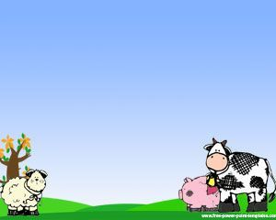
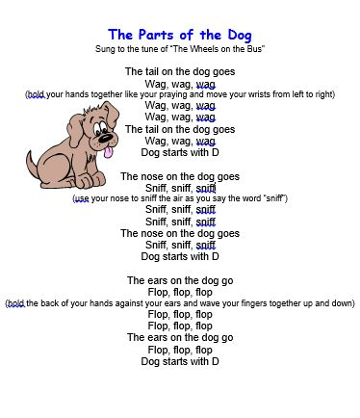
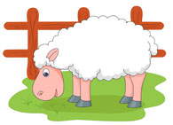
Level 1 Calendar
September 2024
Theme – My Farm and Pet Animal Friends
Baa Baa Black Sheep
Baa Baa black sheep Have you any wool
Yes sir yes sir Three bags full
One for my master
One for the dame One for the little boy
Who lives down the lane.
OLD MAC DONALD
Old MCDONALD had a farm
E-I-E-I-O
And on his farm he had a cow
E-I-E-I-O
With a moo moo here
And a moo moo there
Here a moo, there a moo
Everywhere a moo moo
Old McDonald had a farm
E-I-E-I-O
Farm Song
The pigs On The farm say “oink,oink,oink”
The cow on the farm say “mo,mo,mo”
The Sheep on the farm say “Baa,baa,baa”
The goats on the farm say “Meh,meh,meh”

Slide 3
IMPORTANT POINT:
On 5th September, we will celebrate Teacher’s Day. Children are encouraged to dress up as their teachers and speak a few lines or enact like them.
The timings on 5th September will be: 9:00AM to 11:00AM. ( Dispersal will begin by 10.45 AM

